Slide 1
How to Build a Computer
Demystifying Hardware
By Liam Osman

Slide 2
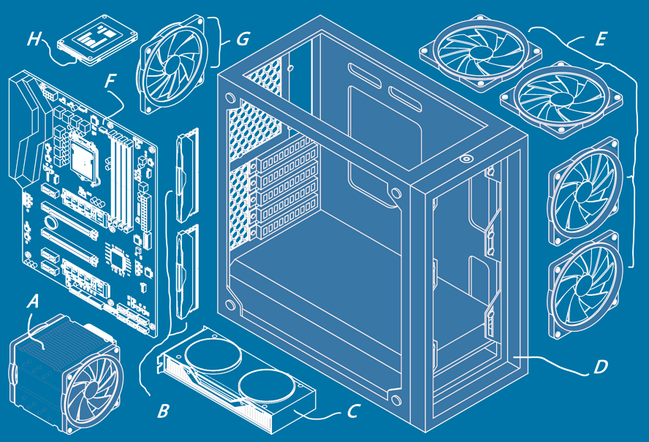
Conclusion
Case
Motherboard
CPU
RAM
Storage
GPU
Power
Cooling
Conclusion

Slide 3
Case

Slide 4
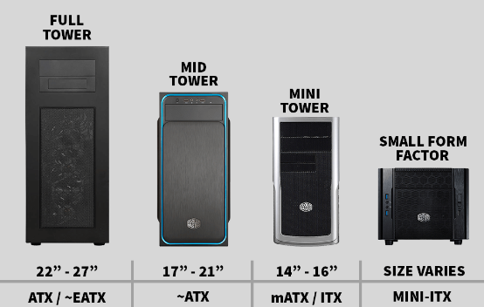
Case Sizing
4 Main Sizes corresponding with motherboard sizes
EATX
ATX
micro ATX
Mini ITX
Has built in connector ports for cables and external drive bays
Lets airflow in for your pc (more on that later)
https://www.easypc.io/pc-cases/

Slide 5
What Case to Choose?
Whatever you want! Just make sure it has:
Your motherboard size
The right external connectors you want
Sufficient airflow

Slide 6
Motherboard

Slide 7
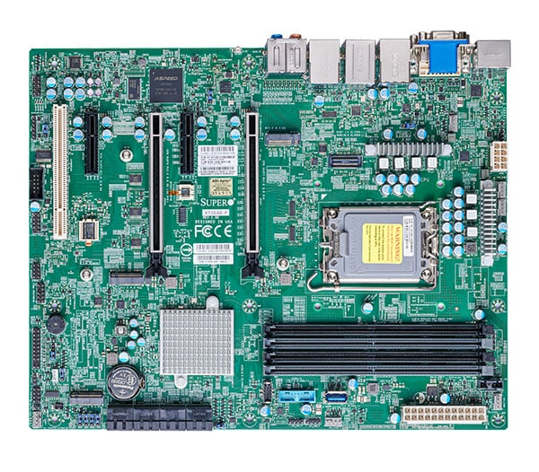
Motherboard Overview
The “skeleton” of the computer
All components and cables plug into motherboard to connect
Has onboard Basic Input Output System (BIOS) to start the PC
Lots of built in components for handling power delivery and I/O
The chipset processes I/O for you
Many ports on the back of your PC
A coin cell battery saves your settings and time while it’s off
https://www.supermicro.com/en/products/motherboard/x13sae-f

Slide 8
Motherboard BIOS
If you press f12 / delete / f2 etc. as your computer starts up, you’ll enter BIOS to configure your computer launch settings
Every BIOS is different, generally differentiated by company
Your settings in BIOS are stored with power on and will be reset if your coin cell battery dies (but that takes years in most cases)
Updating firmware on Motherboard from time to time may fix issues or improve performance as the creators optimize it

Slide 9
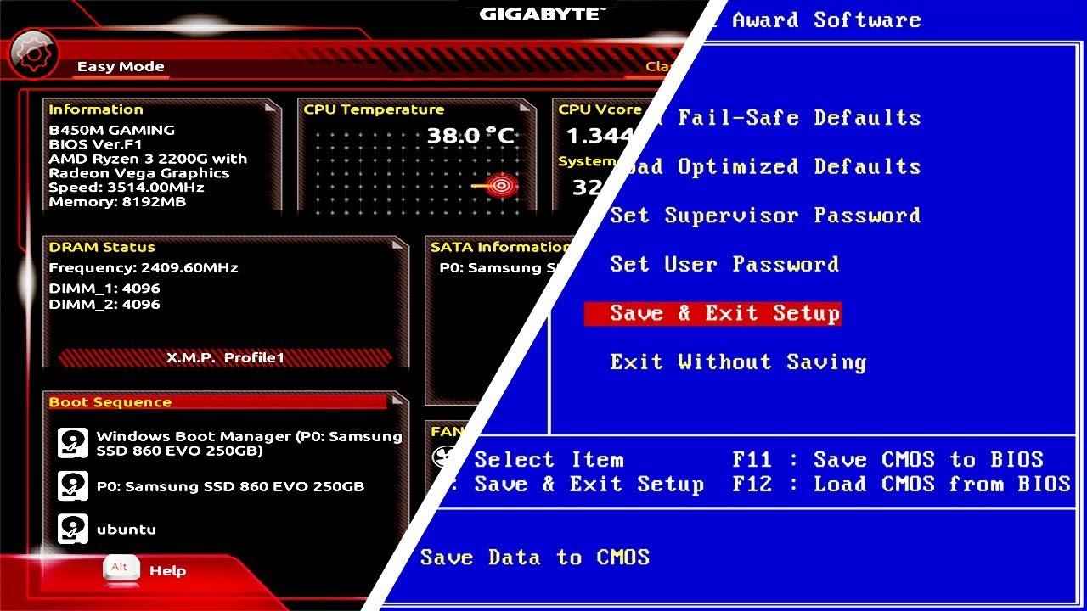
Motherboard BIOS Example (New/Old)
https://youtu.be/ezubjTO7rRI?si=pdVKoZSyS95ulaCc

Slide 10
What can you do in BIOS?
See how your system is performing and what parts are in it
Choose your boot drive / launch settings or manually boot
Change how fast your fans blow to make them better or quieter
Sometimes you can update your BIOS from within BIOS
Overclock / tune performance of power (can brick your parts)

Slide 11
What Motherboard Should I Get?
You just have to make sure it’s compatible with everything!
It has to be compatible with both your case size
It has to be compatible with your given CPU chipset
Make sure it has the right slots for extensions and I/O you want

Slide 12
CPU

Slide 13
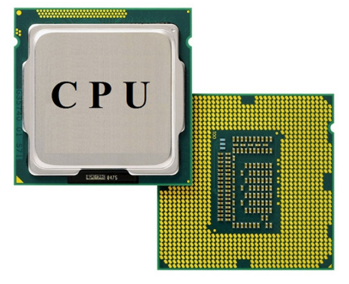
What Does the CPU Do?
The Central Processing Unit (CPU) runs all the main processes for you
Modern PC both run the same Instruction Set Architecture x86
Can have up to 60 Billion transistors (little gates) on a single chip now
The transistors work together to add numbers 6 billion times a second
https://www.easeus.com/knowledge-center/gpu-vs-cpu.html

Slide 14
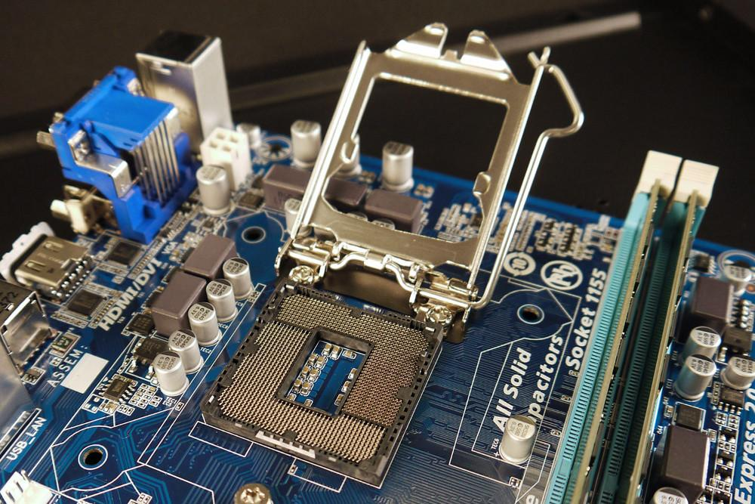
Where Does the CPU Go?
The CPU socket is a large part in the motherboard which will hold your CPU to the contact pins in the motherboard
The pins inside of a socket / CPU are very delicate, so be careful not to bend them any
https://www.digitaltrends.com/computing/what-are-intels-lga-processor-sockets/

Slide 15
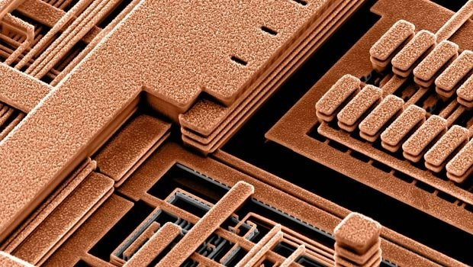
What’s Inside the CPU?
Transistors only nanometers apart from each other in some cases
Has to be viewed through a very strong form of magnification
https://www.quora.com/What-does-the-inside-of-a-processor-look-like

Slide 16
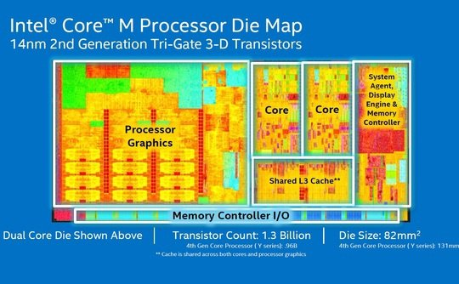
CPU Structure
Each part has its own functions
Cores are the main calculator
I/O and control parts to interface with the rest of the PC
Graphics
https://www.quora.com/What-does-the-inside-of-a-processor-look-like

Slide 17
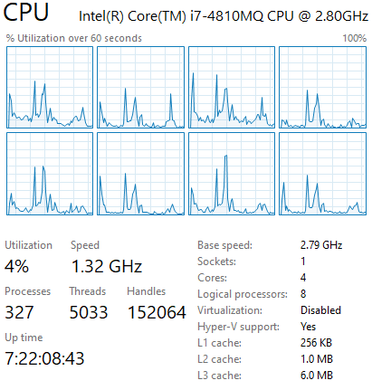
CPU Multithreading
Modern CPUs have many cores which can each simultaneously do calculations and operate to make your computer faster
Not all programs and operations are designed to be multithreaded (run on different cores) but an increasing amount are nowadays
More cores = more better
My task manager multithreading performance

Slide 18
What CPU Is Best?
Buy a latest gen CPU with as much money as the budget allows!
Your CPU is the main determinant of how fast your computer is, and you get what you pay for. Old ones are typically overpriced
More cores will help if you like to run a lot of things at once
Top end CPUs have diminishing returns i.e. not much faster than a cheaper one but costs way more in price and cooling

Slide 19
RAM

Slide 20
What is RAM?
Random Access Memory (RAM) is the main memory of your PC.
It stores all your data you’re working on and currently looking at.
Not to be confused with storage, which will come later. RAM is:
Volatile (Destroyed when it loses power)
Fast (Has to run very quickly with the CPU)
Expensive (Made of semiconductors like a CPU)

Slide 21
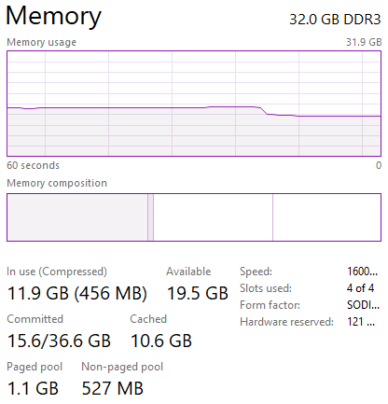
How Does it Help Me?
The more RAM you have, the more things you can have open
When you run out of RAM, everything gets VERY slow
Some tasks like video editing and processing scientific data require a lot of RAM just to function right
My RAM usage after I closed some Chrome tabs

Slide 22
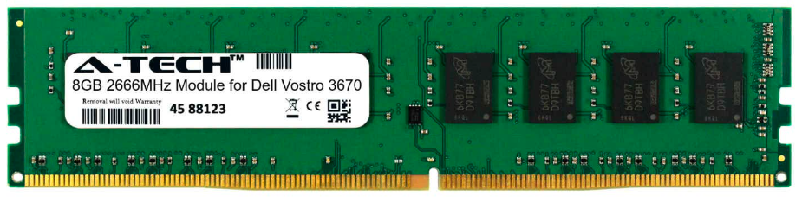
Ok, But What Does RAM Look Like?
Ram comes in small chips attached to a stick shaped circuit
RAM sticks usually have a sticker with their information printed
There is several versions of RAM, the newest being DDR5

Slide 23
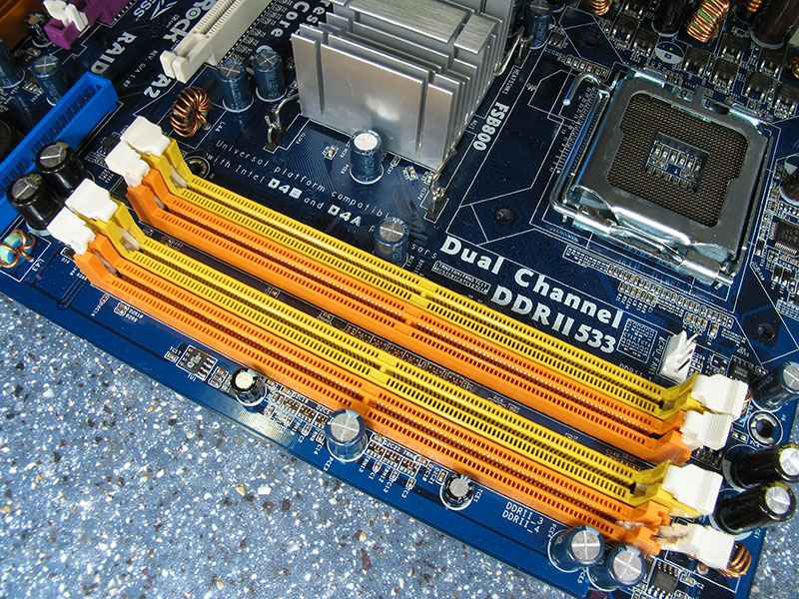
Where it go???
RAM sticks go into the large DIMM slots located right next to the CPU socket
For timing purposes which enhance PC performance, RAM should be inserted in a specific pattern
https://superuser.com/questions/671533/what-do-motherboard-ram-slot-colors-mean

Slide 24
How Much RAM Do I Need??
Most people only need 16-32 Gb of RAM on a PC nowadays.
Make sure it’s a version compatible with your motherboard
If you have a special task that needs more RAM, you’ll know it
RAM sticks will market speed but don’t worry too much about it

Slide 25
Storage

Slide 26
Storage Overview
Storage is what saves all our files in our computers
The computer has to read data off our storage every time we load something new, and write it when we save it
There are 2 common types of drives we use to store data
Hard Disc Drive (HDD)
Solid State Drive (SSD)

Slide 27
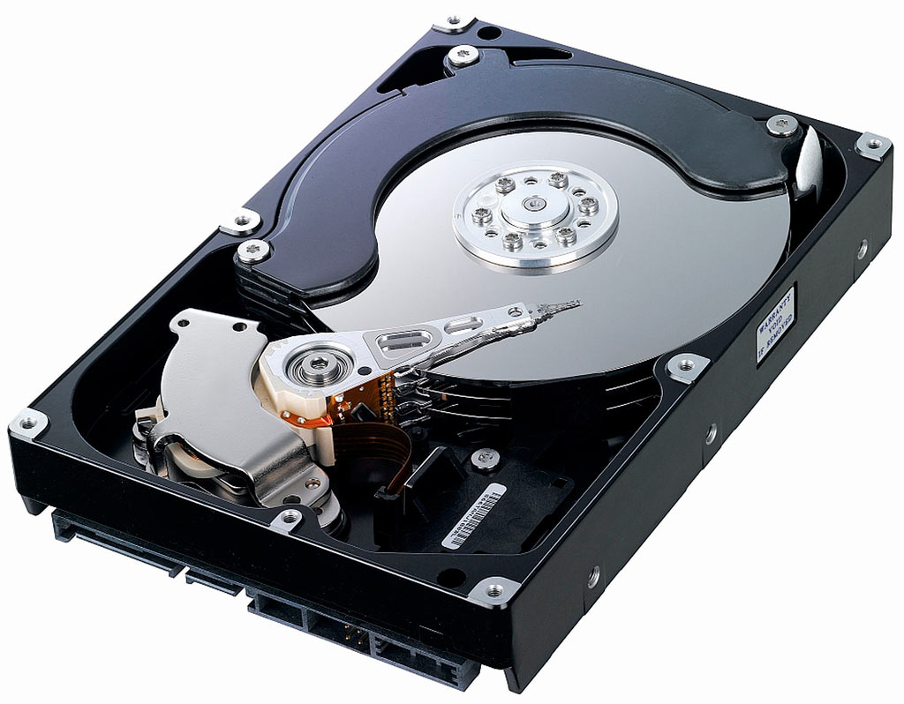
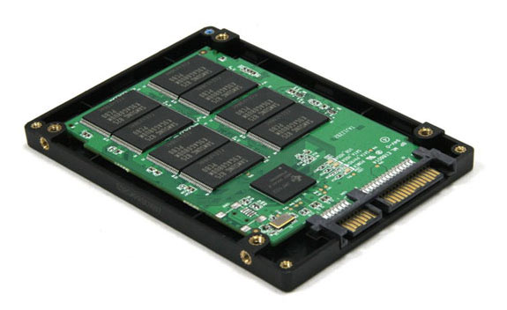
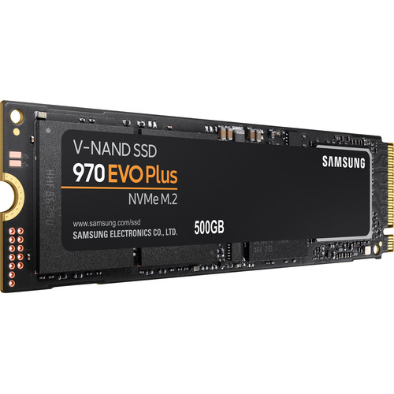
Which Drive Is Best?
Hard Disc Drive
Solid State Drive
Data stored on Disks like CD
Very large capacity
Cheaper than SSD
Can recover data if it fails
Data stored on flash chips
Faster load times
Makes no noise in use
Much smaller and lighter
http://www.datarecoveryspecialists.co.uk/blog/what-is-inside-a-hard-drive
https://www.backblaze.com/blog/hdd-versus-ssd-whats-the-diff/

Slide 28
Storage Recommendation
How much storage you need is very much up to your needs. But:
You probably want at least one SSD to install your operating system onto. This will make navigating on your PC must faster
Any software or games which need to load fast also go on SSD
If you need a lot of storage for things like video or music, make use of HDDs to store a lot of things for relatively cheap

Slide 29
GPU

Slide 30
What’s a GPU really do?
A Graphical Processing Unit is a processing chip, like a CPU
Unlike a CPU, GPUs are significantly less general purpose
GPUs are designed for primarily one thing… computations
While a CPU will have 2-32 cores, a GPU could have 10000
10000 threads running at once make the GPU much faster
Very important tools for anything that requires parallel computation, such as engineering models, video editing, crypto mining and some games

Slide 31
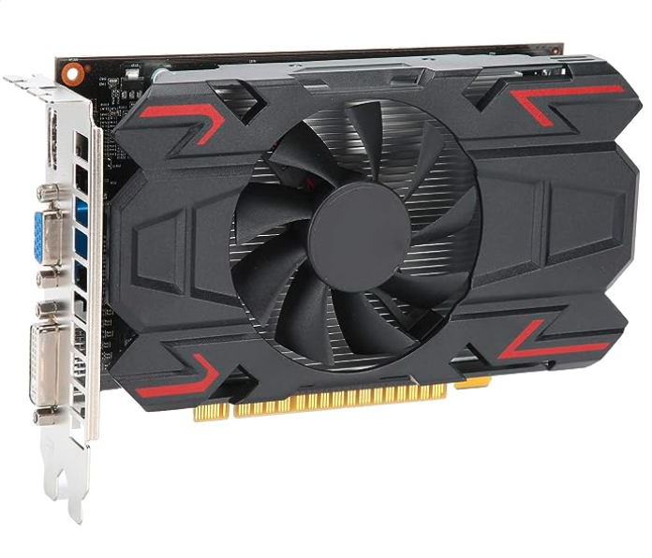
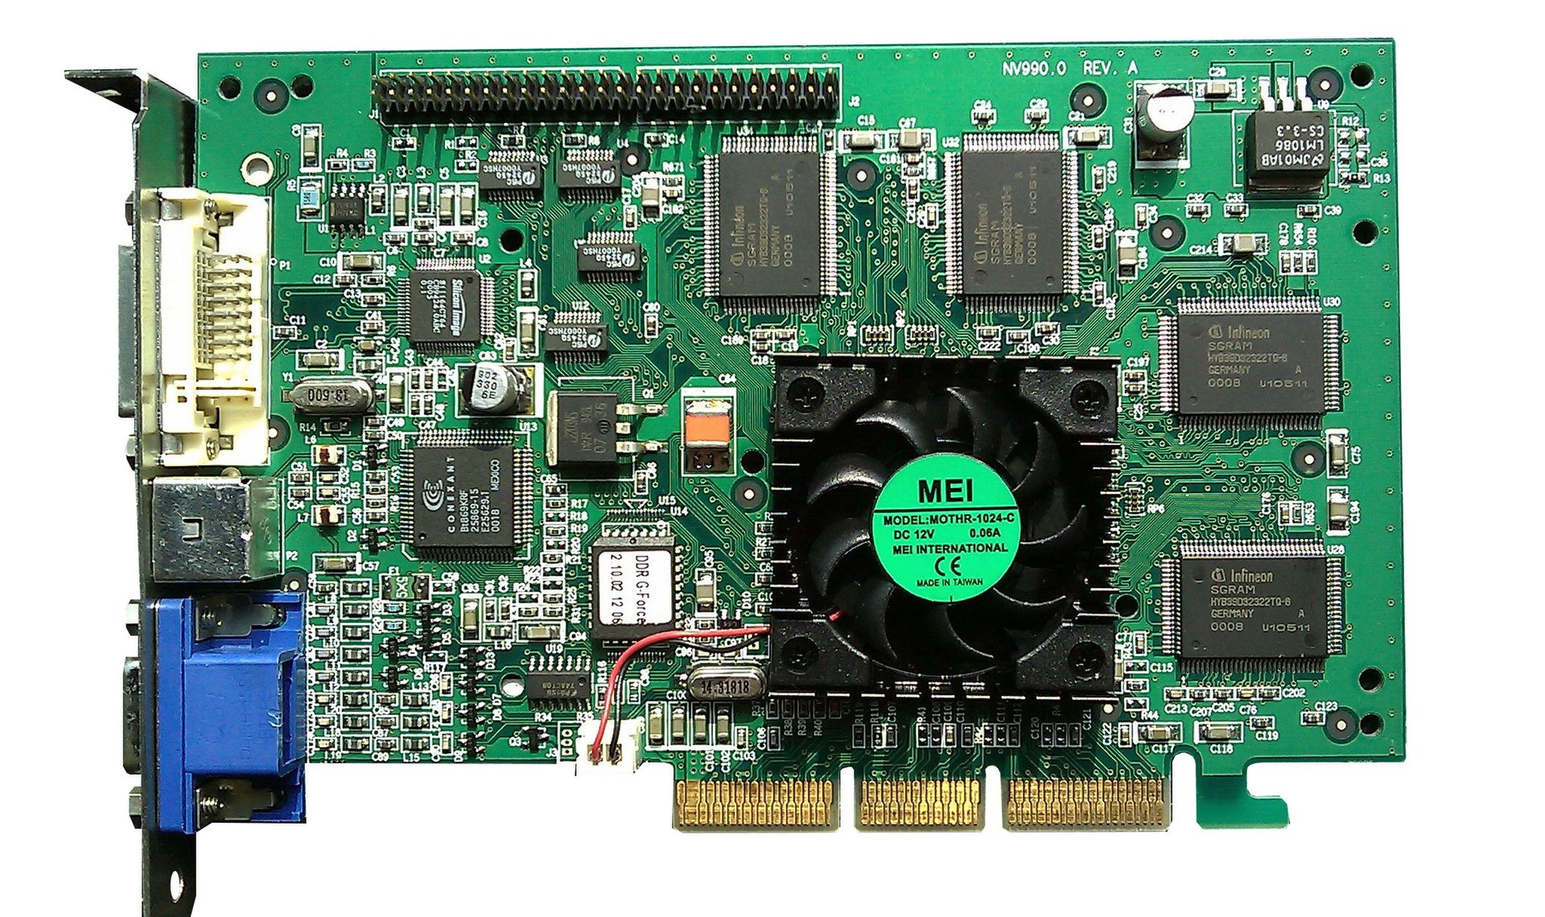
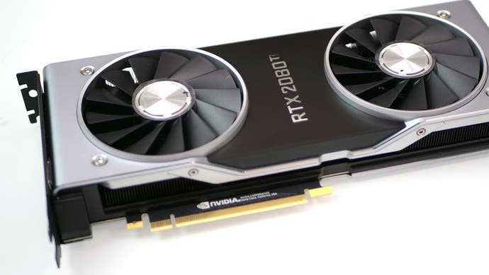
Common GPUs
GPUs are usually found on large graphics card boards which will slot into the PCIe slot of a motherboard
These cards contain some other chips for handling video compression and encoding, output ports, etc.

Slide 32
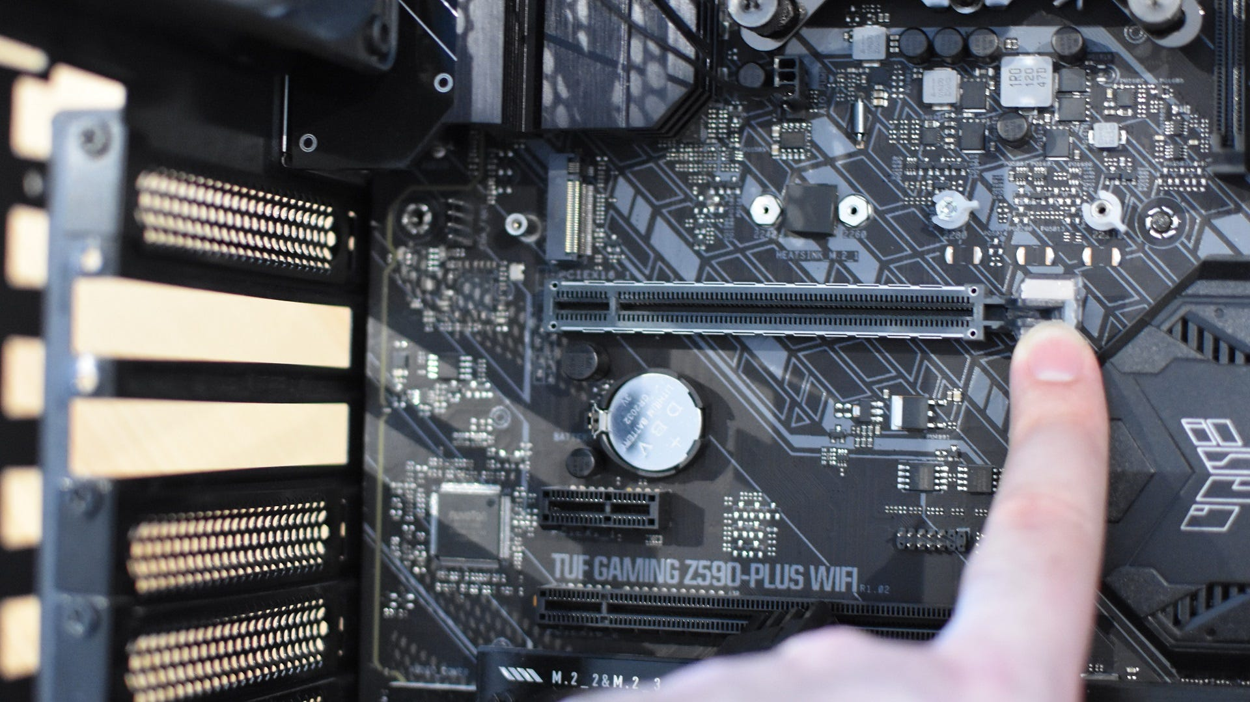
PCIe Slots
GPUs and other external cards are put into a PCIe slot of a motherboard so the CPU can talk to it.
PCIe slots are located in a row near the back of the computer, under the CPU
Examples of other external cards include sound cards, wireless receivers, extra memory, or even a second Graphics card

Slide 33
Which GPU Should I Get?
GPUs are very expensive nowadays, but you’ll want one if:
You edit a lot of videos or other large data / image sets
You want to play big games; GPUs scale your fps almost linearly
You want to mine cryptocurrency (although ASICs are better)

Slide 34
Power

Slide 35
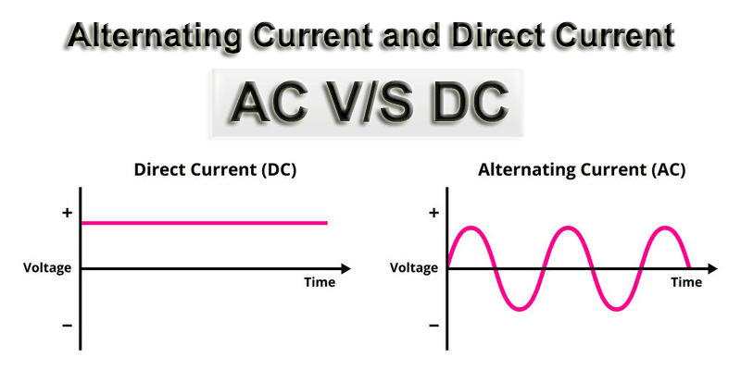
Current
https://www.electronicsforu.com/technology-trends/learn-electronics/difference-between-ac-and-dc

Slide 36
AC/DC
The power supply (PSU) to a computer is like a phone charger
Converts AC from your plug into DC for the computer to use
Often as much as >1000W power output for a PC nowadays
PC demands high quality and stable DC power to not brick

Slide 37
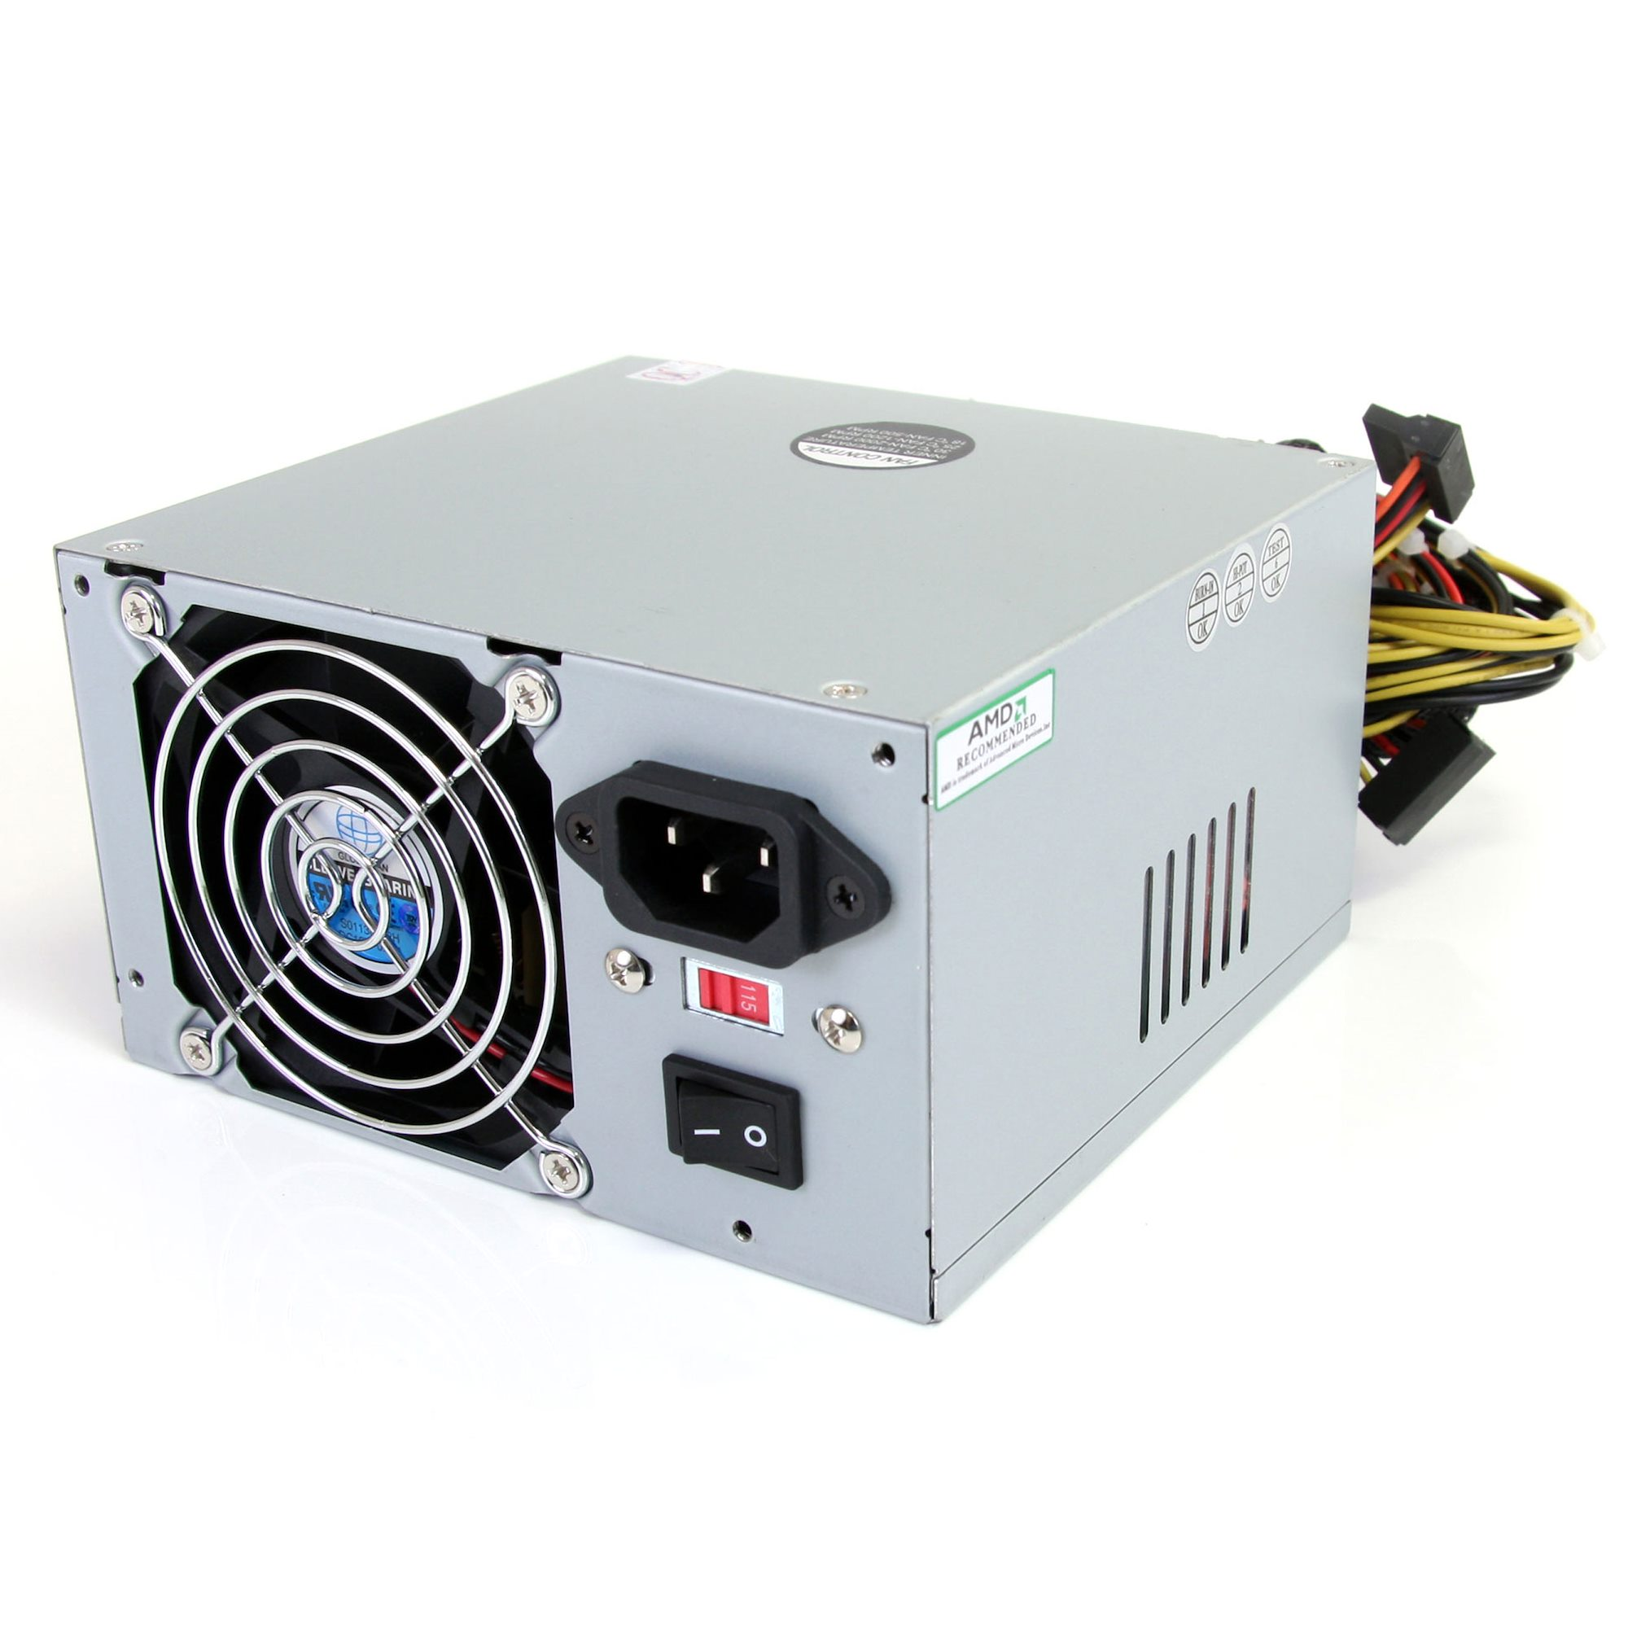
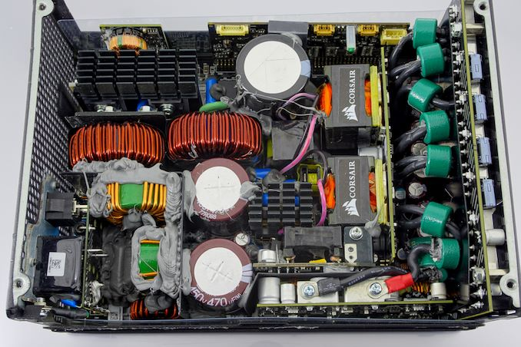
Don’t Open a PSU; You Could Die
https://www.startech.com/en-us/computer-parts/atx2power450
https://www.anandtech.com/show/12056/best-psus

Slide 38
How Big Does My PSU Have to Be?
Just make sure it covers your CPU and GPU power consumption
Look up the information of your max power consumption and make sure you have enough for that
Some Power Supplies will provide the same power but quieter

Slide 39
Cooling

Slide 40
Staying Cool
Computers are basically toasters with extra steps
Every watt of energy (almost) put into your computer will turn into heat, which you need to get rid of!
Too much heat will damage parts and slow them down
Heatsinks and case airflow is how we achieve this

Slide 41
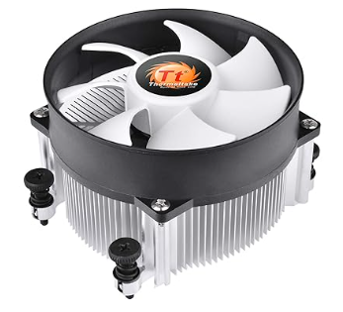
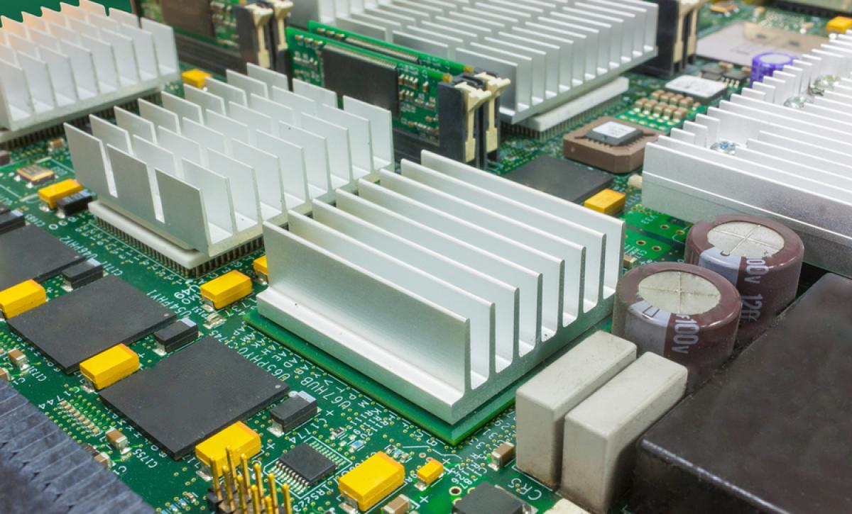
CPU Cooler
Your CPU will need a cooler of its own, if it doesn’t come with it
Many smaller parts have simple heatsinks to radiate heat
Cases also use fans plugged into the motherboard to support
https://resources.altium.com/p/emi-heatsinks-and-what-you-can-do-about-it

Slide 42
What Cooling Do I Need?
A few fans is all that’s typically necessary, but:
A GPU typically comes with its own fans attached
CPUs can come with their own, but check what’s recommended
At least one exhaust and one intake fan is ok for most PCs

Slide 43
Conclusion

Slide 44
Next Events

